Slide 1
Introduction to the Windows 10 Universal Windows Platform Developer’s Guide to Windows 10
Andy Wigley Shen Chauhan

Slide 2

The convergence journey
Xbox 360
Xbox One
Unified core and app platform
Converged
OS kernel
Windows 8.1
Windows 8
Converged
app model
Windows 10
Windows Phone 8.1
Windows Phone 8
Easy for users to get & stay current
Windows Phone 7.5
Windows on Devices

Slide 3
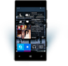

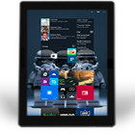
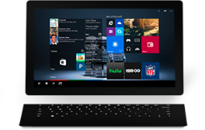

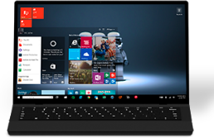

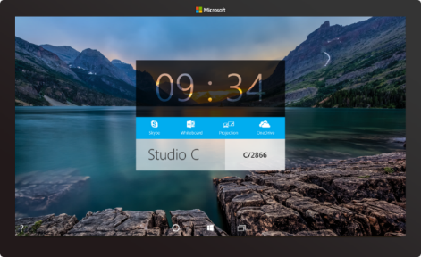

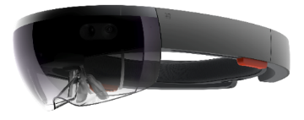



2-in-1s (Tablet or Laptop)
Classic Laptop
Desktops & All-in-Ones
Phone
Phablet
Small Tablet
Large Tablet
Windows 10
Surface Hub
Xbox
Holographic
IoT

Slide 4
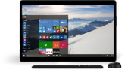
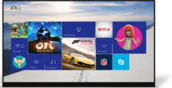
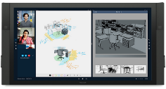
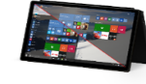

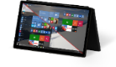
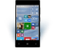
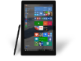
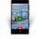











PC
XBox
Mobile
Surface Hub
Devices +IoT
HoloLens
Universal Apps
Multiple device families
Adaptive User Interface
Reuse Existing Code
Natural User Inputs
One Store + One Dev Center
One SDK + Tooling
One Universal Windows Platform

Slide 5
WPF
WF
MFC
XAML
HTML
Bridging technologies
Obj.C
iOS
Java
Android
Web
hosted
Win32
desktop
DirectX
.Net
languages
C++
.Net
languages
C++
& CX
WWA
.Net
runtime
Universal Windows Platform
Windows 10
operating system

Slide 6
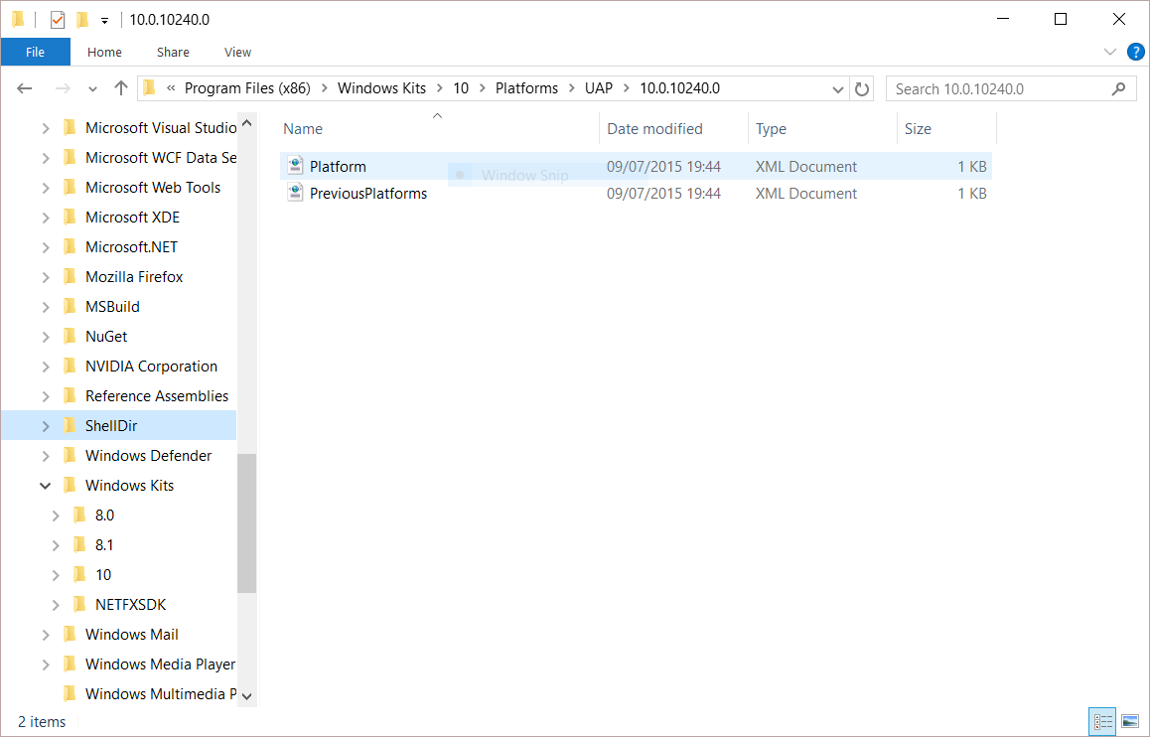
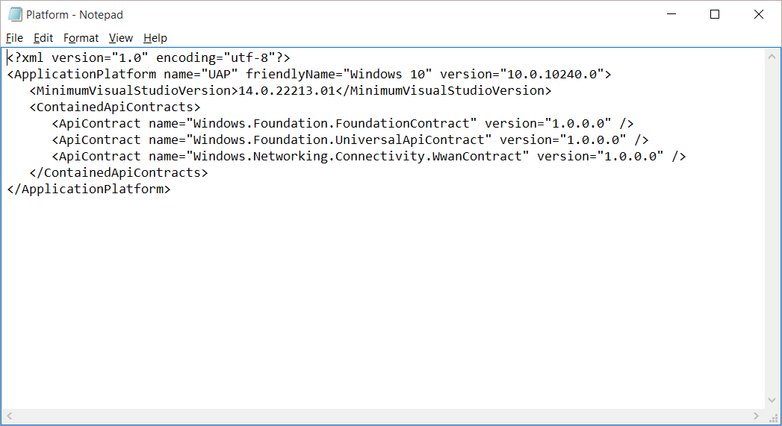
Universal Windows Platform
A single API surface
A guaranteed API surface
The same on all devices
Universal Windows Platform
Windows Core
Desktop
Device
Phone
Device
Xbox
Device

Slide 7
A whole lot of APIs…
Storage
DirectX 12
Speech and Cortana
Networking
NFC and Bluetooth
Holographic
Audio and Video
Appointments/Calendar
Authentication Broker
Background Transfer
Maps and Location
Sensors: Accelerometer, light, magnet …
Tiles and Notifications
App to App and App Services
Inking
XAML
Background Tasks
Data Roaming
Data.XML
Media Casting
Many, many more….

Slide 8
Apps don't target Windows 10, apps target the UWP

Slide 9
<Dependencies>
<TargetDeviceFamily
Name="Windows.Universal"
MinVersion="10.0.10240.0"
MaxVersionTested="10.5.0.0"/>
</Dependencies>

Slide 10
The Universal Windows Platform can update at its own cadence

Slide 11
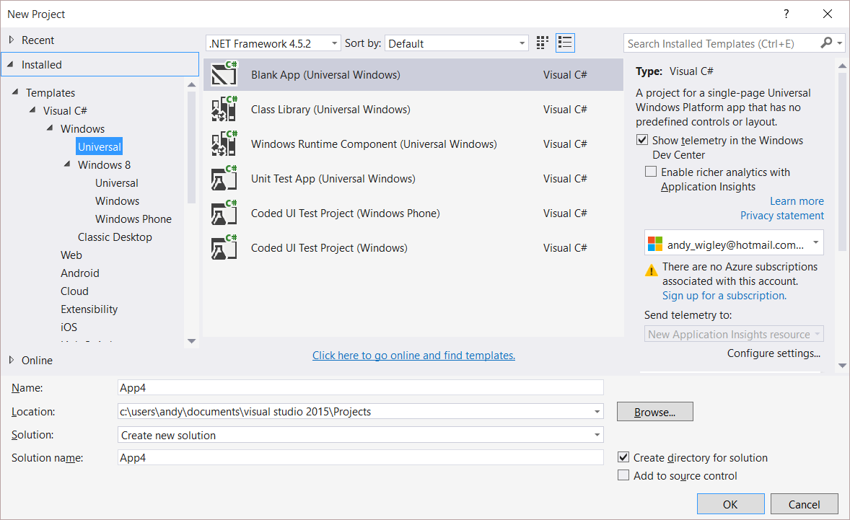
Windows app
A single binary
Running on any device
Testing for capabilities
Adjusting to devices
Windows App
Universal Windows Platform
Windows Core
Desktop
Device
Phone
Device
Xbox
Device

Slide 12
Demo: Hello devices

Slide 13
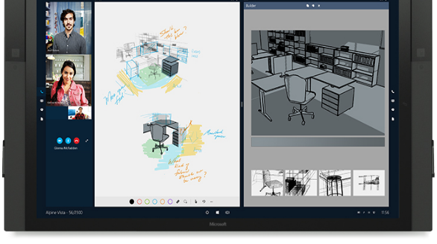
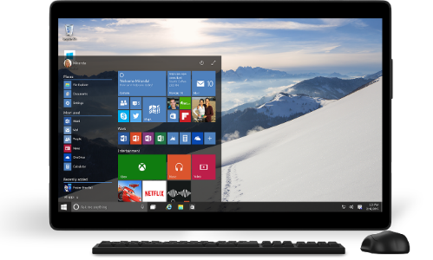
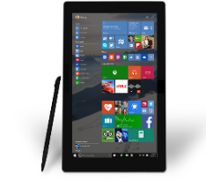

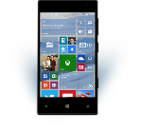

Universal Windows Platform
One Operating System
One Windows core for all devices
One App Platform
Apps run across every family
One Dev Center
Single submission flow and dashboard
One Store
Global reach, local monetization Consumers, Business & Education

Slide 14
One Windows
Desktop SKU
Mobile SKU
Xbox SKU
IoT SKU
IoT headless SKU
Surface Hub SKU
Holographic SKU
PC
2 in 1
Tablet
Phablet
Phone
Xbox
Band
Raspberry Pi
Surface Hub
HoloLens
Home Automation

Slide 15
Each family offers its own shell and adds features to those it inherits

Slide 16
Adaptive UI

Slide 17
Adaptive design
Responsive design
Flexible layout responds to small changes
Many controls handle basic responsiveness
Adaptive design
Smart layout adjusts to large changes
Features like visual states aid in this design
Tailored design
A device-specific app can simplify design
Some devices have unique design languages

Slide 18
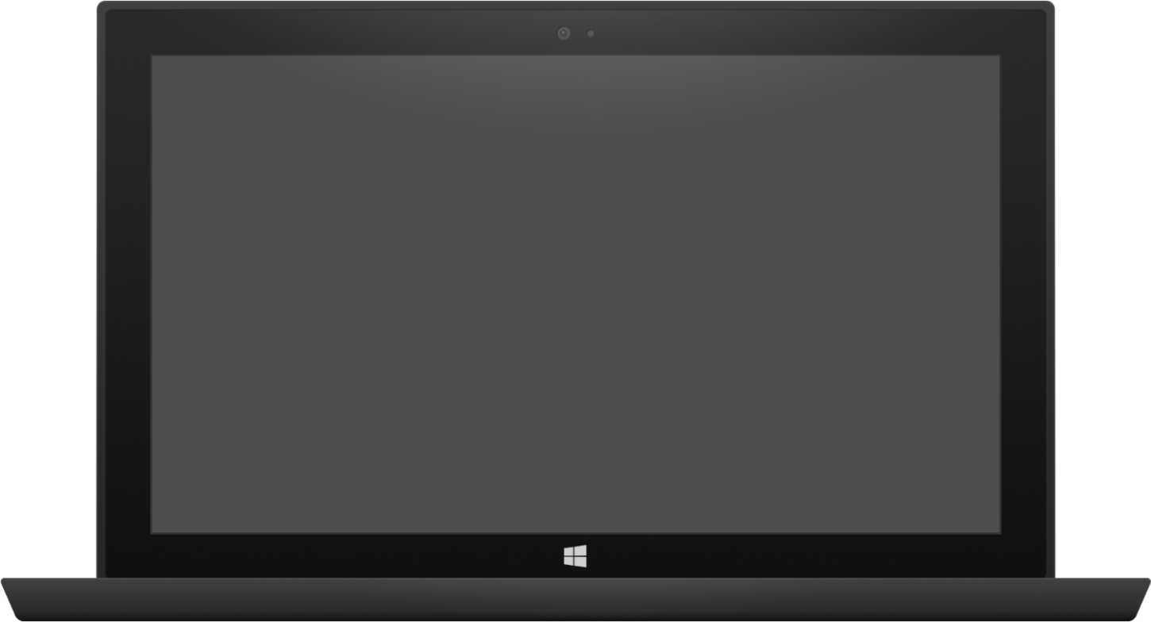

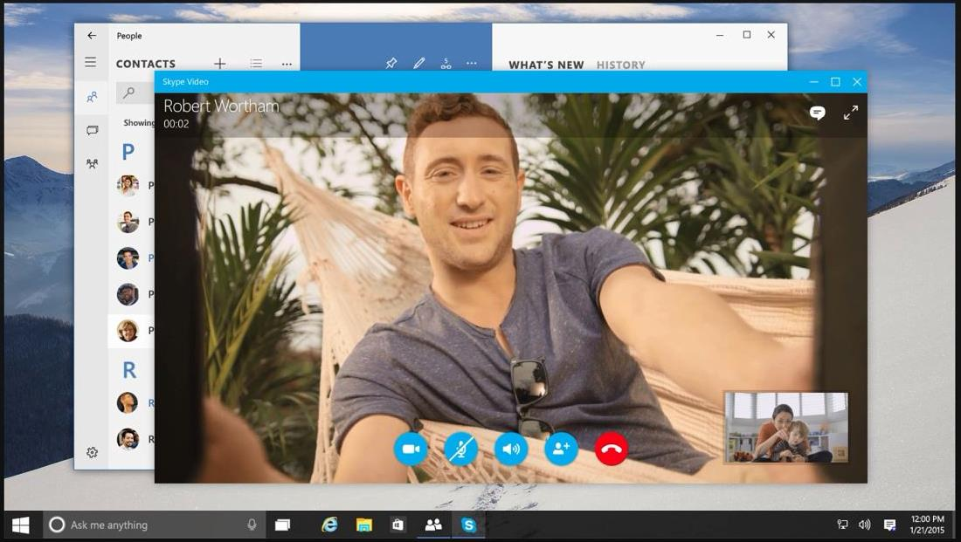

Adaptive design
Tablet (landscape) / Desktop
Phone (portrait)

Slide 19
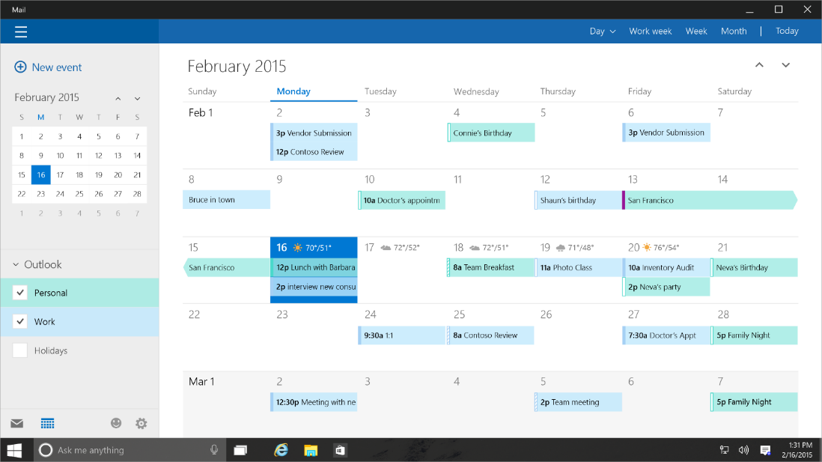
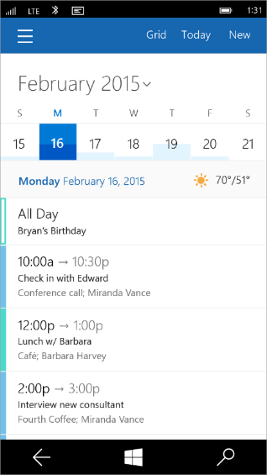
Tailored design
Tablet (landscape) / Desktop
Phone (portrait)

Slide 20
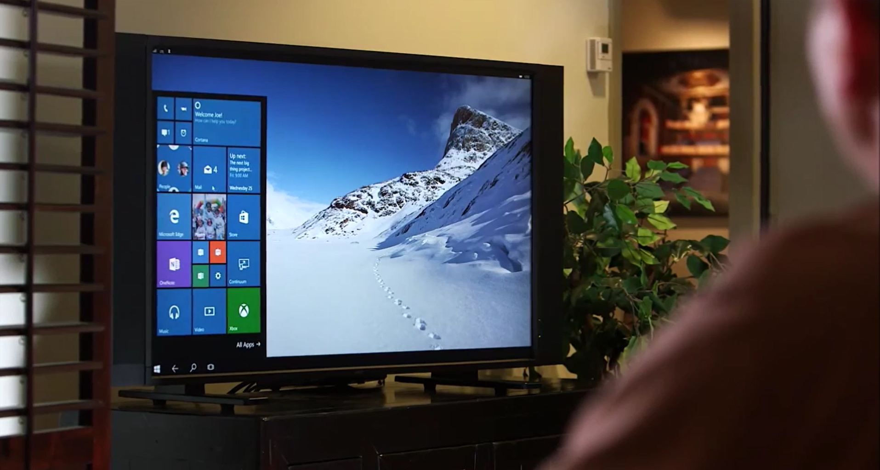
Continuum for Convertibles and Phones
Continuum for convertibles and Phones

Slide 21
Users love apps that give a great experience on all their devices

Slide 22
Demo: Adaptive UI

Slide 23
Adaptive code

Slide 24
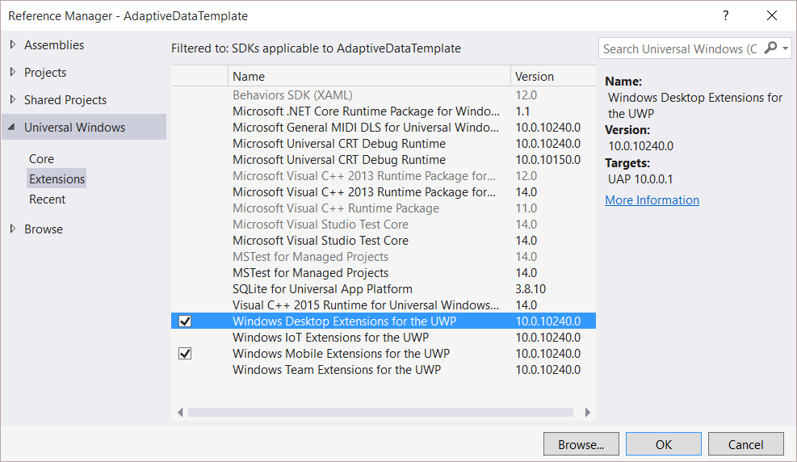
Platform extensions
Device-specific API
Family-specific capabilities
Compatible across devices
Unique update cadence
Windows App
Desktop
extension
Phone
extension
Xbox
extension
Universal Windows Platform
Windows Core
Desktop
Device
Phone
Device
Xbox
Device

Slide 25
Platform extensions don't invalidate binaries on other devices

Slide 26
UWP
UWP
UWP
UWP
Windows Core
Windows Core
Windows Core
Windows Core
Desktop
Mobile
Xbox
More…

Slide 27
Test capabilities at runtime
Use Adaptive Code to light-up our app with capabilities on specific device families
Testing for capabilities and namespaces
var api = "Windows.Phone.UI.Input.HardwareButtons";
if (Windows.Foundation.Metadata.ApiInformation.IsTypePresent(api))
{
Windows.Phone.UI.Input.HardwareButtons.CameraPressed += CameraButtonPressed;
}

Slide 28
Demo: Adaptive code

Slide 29
Microsoft Edge and Web Platform

Slide 30

Microsoft EdgeHTML
Microsoft Edge
JS Symbols
ES6 Numbers Built-Ins
DOM L3 XPath
Rest parameters
4200+ interoperability improvements
ES6 Template Strings
Arrow function
asm.js
JS iterators
<img srcset>
Web Audio API
ES6 classes
GamePad API
Content Security Policy
Video tracks
ES6 Promises
Selection API
ES6 Math Built-Ins
HTTP Strict Transport Security
Touch Events
Media Queries L4 Interaction Media
ES6 String Built-Ins
ES6 WeakSet
getUserMedia()
ES6 Spread
preserve-3d
ES6 Proxies
ES6 Object Built-Ins
HTTP/2
WAV audio
HTTP Live Streaming
Date <input> types
Motion JPEG
Generators

Slide 31
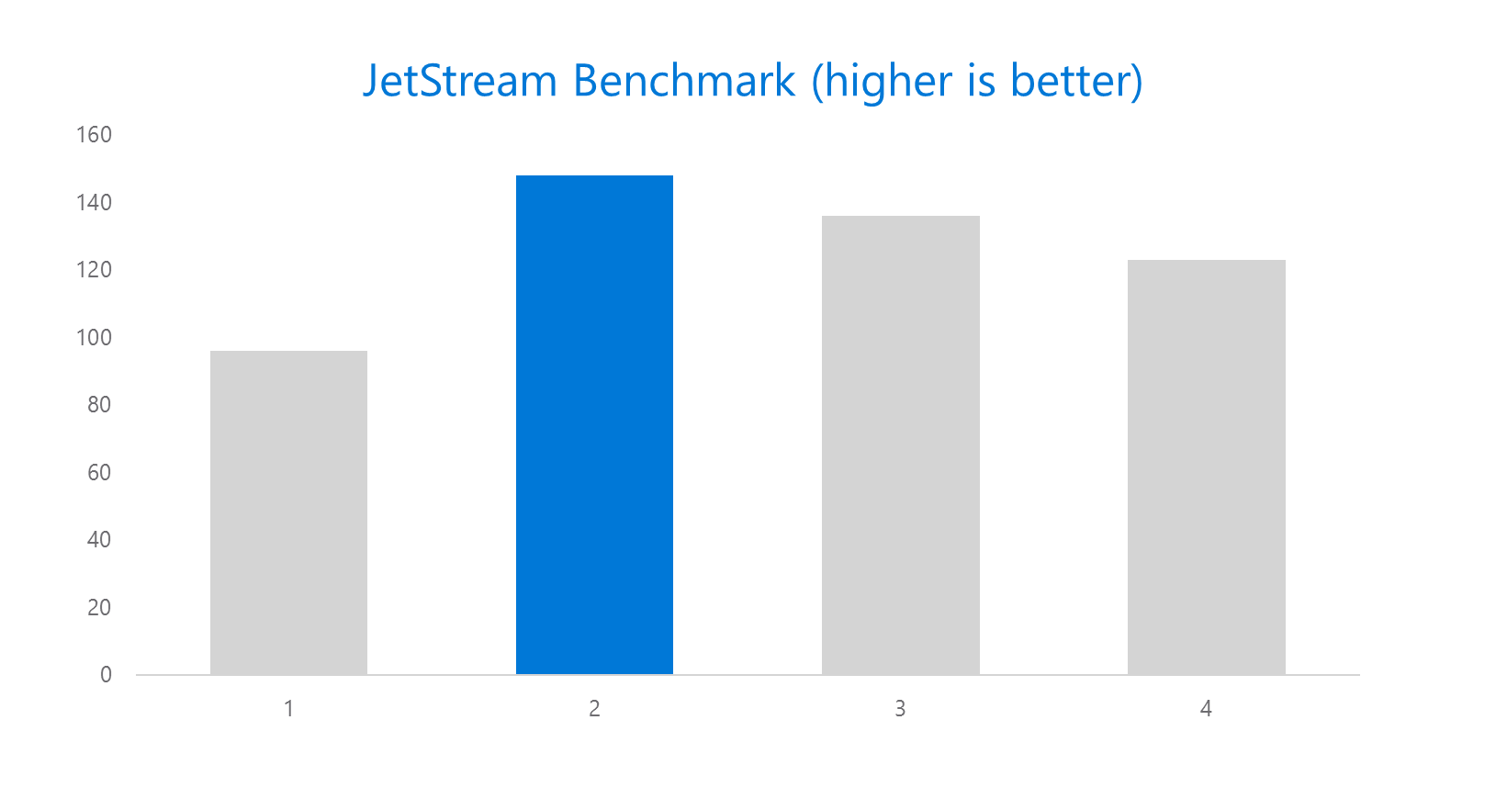
Microsoft Edge

Slide 32
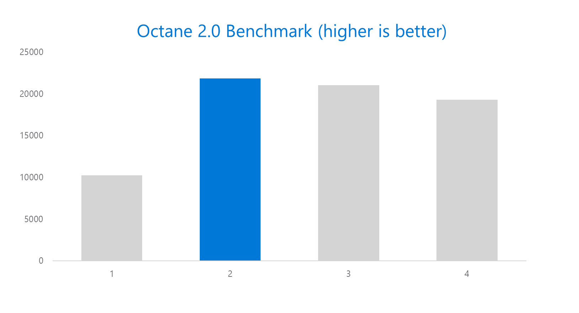
Microsoft Edge

Slide 33
Bridging Technologies

Slide 34
Web Apps
pp
NEW: Hosted Web Apps
Bring your website experience to the Windows Store
Leverage your web investments and developer workflow
Full access to Universal APIs, including
Tiles, Notifications, Camera, Contact List, Calendar
.appx
HTML
CSS
JS
Universal Windows Platform

Slide 35
Demo Microsoft Edge, Hosted web apps

Slide 36
Windows Bridge for Android (a.k.a. Project Astoria)
Tooling to allow apps written for Android™ to run on Windows 10 Mobile with few changes required
Microsoft Interoperability library redirects calls to Google services to Microsoft services
Submit .apk to the Store
Extend to call subset of UWP APIs
Tiles and Notifications
Sign up for limited developer preview at http://uwp.dev.windows.com/en-US/uwp-bridges/android

Slide 37
Windows Bridge for iOS (previously known as ‘Project Islandwood’)
Build Universal Windows Apps using Objective-C
Import Xcode® projects into Visual Studio
Build and debug your Objective-C code from Visual Studio
Take advantage of great Windows services
Extend your app to take advantage of Universal Windows Platform features
Get the Developer Preview:
https://dev.windows.com/en-us/uwp-bridges/ios
Code is open source:
https://github.com/Microsoft/WinObjC/

Slide 38
Project Centennial
Package and publish existing .NET and Win32-based Windows applications to the Windows Store
Use Centennial to call common UWP APIs and services
More information coming soon…

Slide 39
Development tools

Slide 40
Visual Studio 2015 Editions
Enterprise
Architecture Modeling, Diagnostics, VSO/ALM & Release Management
Professional
Architecture Validation, VSO/ALM & Feedback Management
Community Editions
Visual Studio Professional Edition

Slide 41
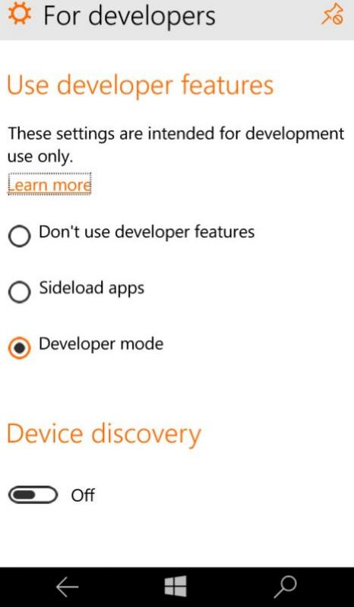
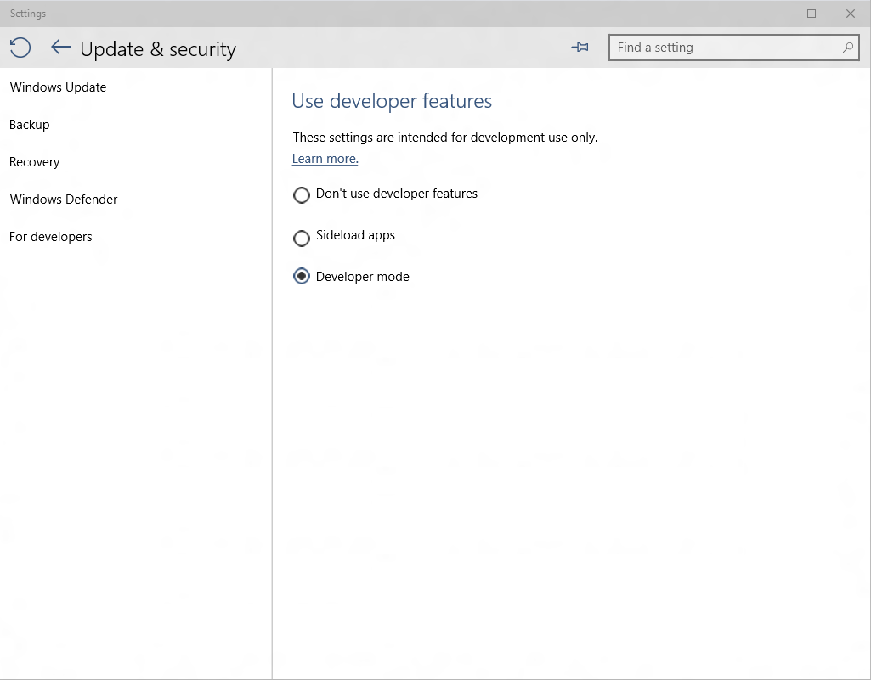
Developer unlock

Slide 42

Where can I develop?
Windows 10
Requires Visual Studio 2015
Windows 8.1 & Windows Server 2012 R2
The Visual Studio designer does not function
Debugging requires a Windows 10 device or Remote Debugging Tools

Slide 43
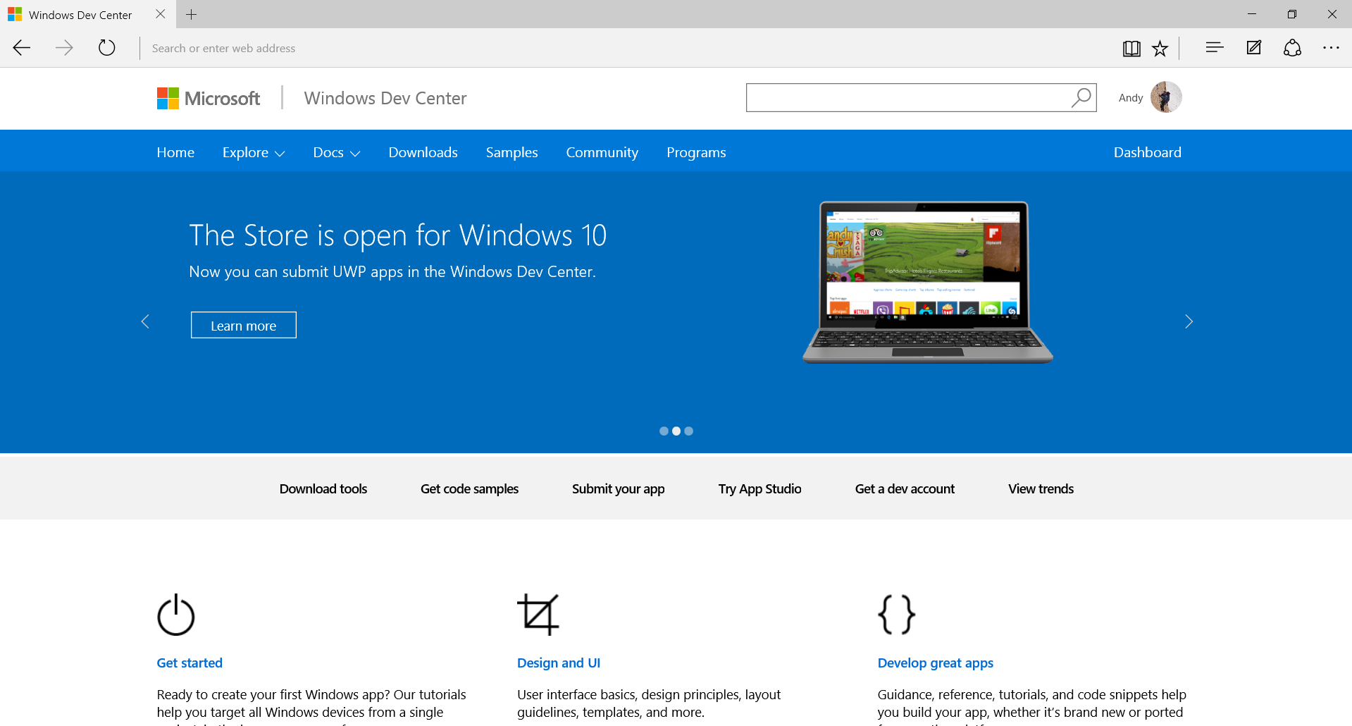
dev.windows.com

